Slide 1

Bert and GPT Models
A Professional Overview of Leading AI Techniques

Slide 2
Phases of Presentation
Introduction
Overview of the Models
Introduction to BERT and GPT Models
Comparison of Architectures
Use Cases of BERT and GPT Models
Conclusion
Background
Future Directions
Industry Application
Advancement in AI models
Challenges and Limitations
Performance Evaluation of Models.

Slide 3
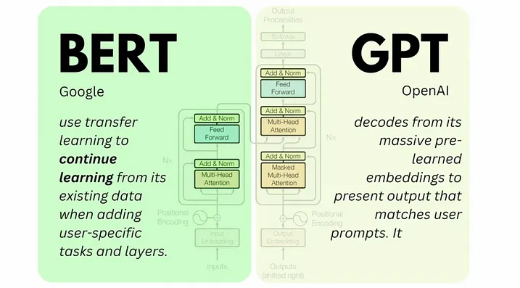
Introduction
What are BERT and GPT? BERT (Bidirectional Encoder Representations from Transformers) and GPT (Generative Pre-trained Transformer) are state-of-the-art deep learning models based on the Transformer architecture, developed by Google and OpenAI respectively.
Why They Matter: These models have revolutionized Natural Language Processing (NLP) by enabling machines to understand, interpret, and generate human language with unprecedented accuracy and fluency.
Objective of This Presentation: To explore the architecture, working principles, differences, and practical applications of BERT and GPT models.

Slide 4
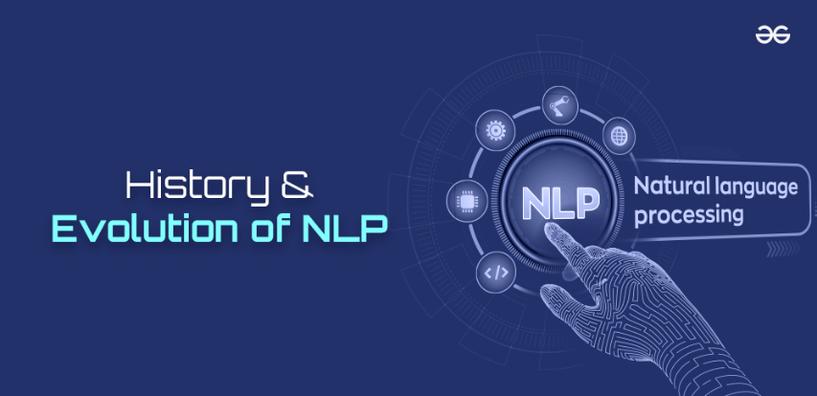
Background and Evolution of NLP
NLP started with rule-based systems and evolved through statistical methods like n-grams and HMMs in 1990s. The shift to deep learning in 2010s introduced RNNs and LSTMs, improving sequence understanding. Major progress came with transformers in 2018—BERT enabled deep bidirectional understanding, while GPT brought powerful generative capabilities. These advances now drive modern language technologies.

Slide 5
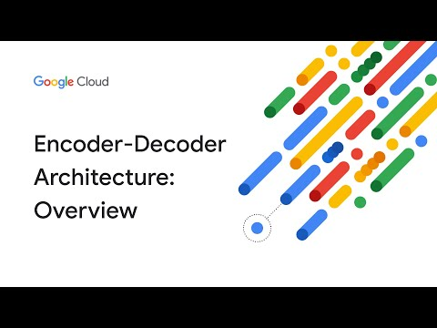
01
Overview of Models
The preceeding sectins will disuss the intricate details of BERT vs GPT Models

Slide 6
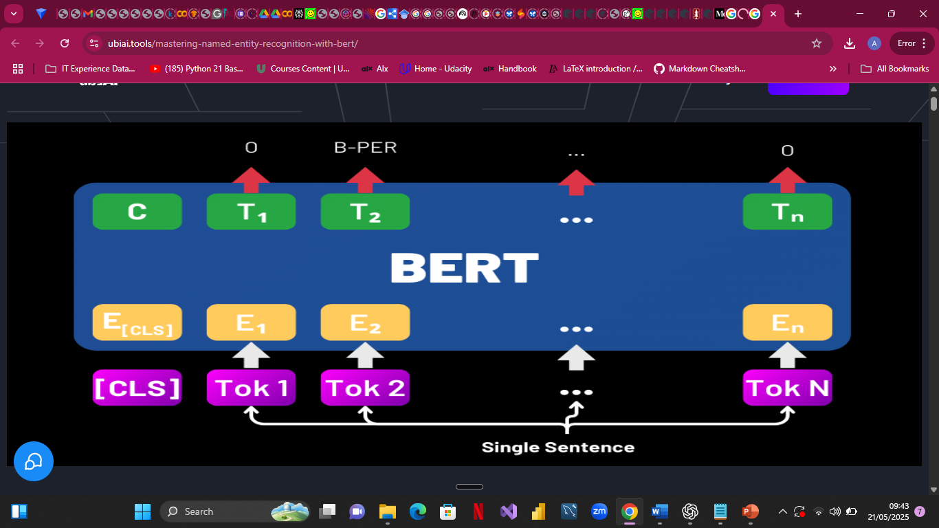
Bert Model
Bert (Bidirectional Encoder Representations from Transformers) is a pre-trained transformer model designed to understand the context of words in search queries, making it invaluable for various NLP tasks. It excels at tasks such as question answering and sentiment analysis by incorporating the surrounding context in a bidirectional manner.

Slide 7
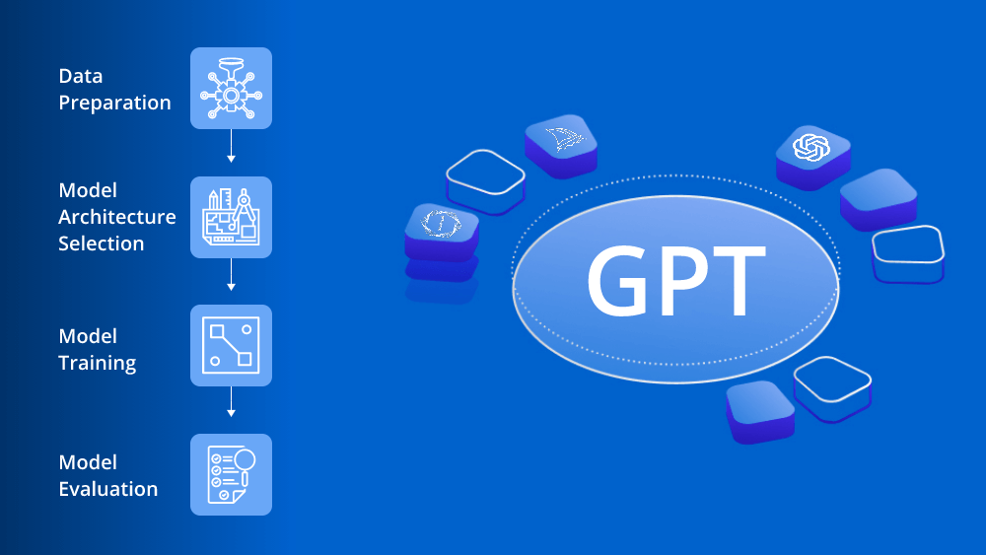
GPT Model
GPT (Generative Pre-trained Transformer) developed by OpenAI and officially released in 2020, is a language model that generates human-like text based on the input it receives. It is widely used for content generation, dialogue systems, and more due to its ability to produce coherent and contextually relevant text continuations.

Slide 8
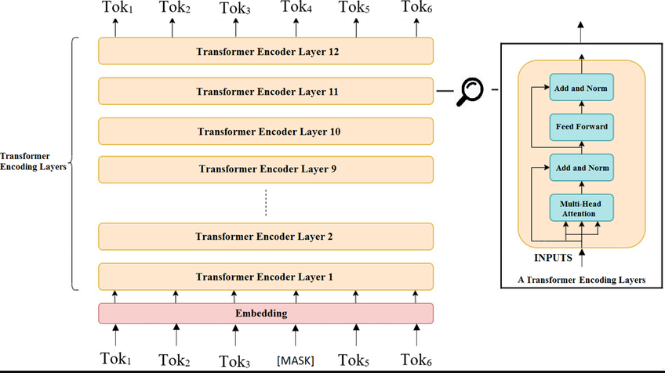
BERT Transformer Architecture
Transformers introduced by (Vaswani et al 2017) serves as a foundation for BERT and GPT, However, BERT (Bidirectional Encoder Representations from Transformers) uses a transformer encoder that reads input tokens in both directions to capture full context. The model is pre-trained using Masked Language Modeling (MLM), where 15% of input tokens are masked and the model learns to predict them, enabling a deep understanding of context.

Slide 9
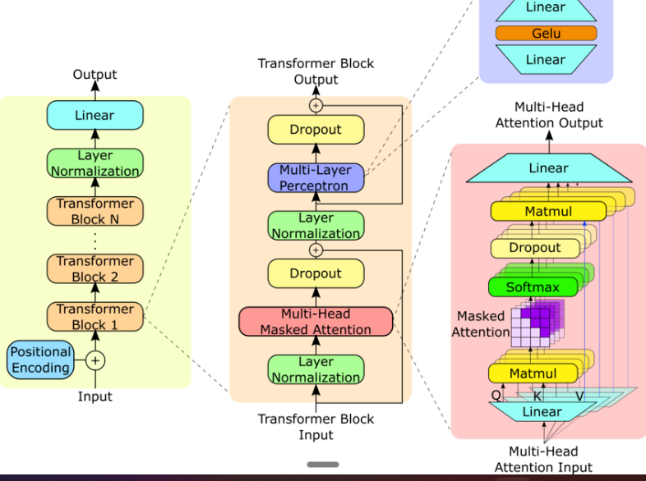
GPT Transformer Architecture
BERT (Bidirectional Encoder Representations from Transformers) uses a transformer encoder that reads input tokens in both directions to capture full context. The model is pre-trained using Masked Language Modeling (MLM), where 15% of input tokens are masked and the model learns to predict them, enabling a deep understanding of context.

Slide 10

02
Future Trends

Slide 11
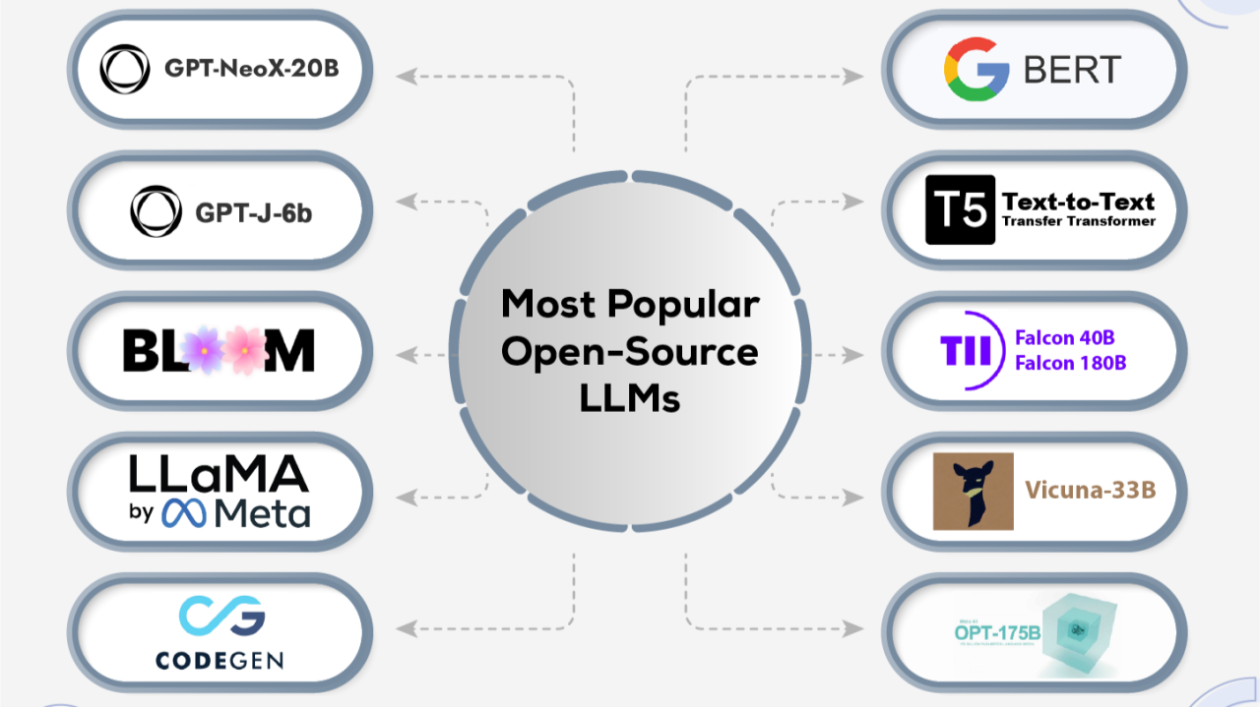
Use cases of Bert and GPT
Bert is used in various applications such as search engines where it improves the accuracy of search results by understanding user intent. Other applications include chatbots and virtual assistants for enhanced natural language understanding. While, GPT finds its application in numerous areas including automated content writing, customer support, and game development, where it can generate narratives or dialogues dynamically, enhancing user engagement.

Slide 12
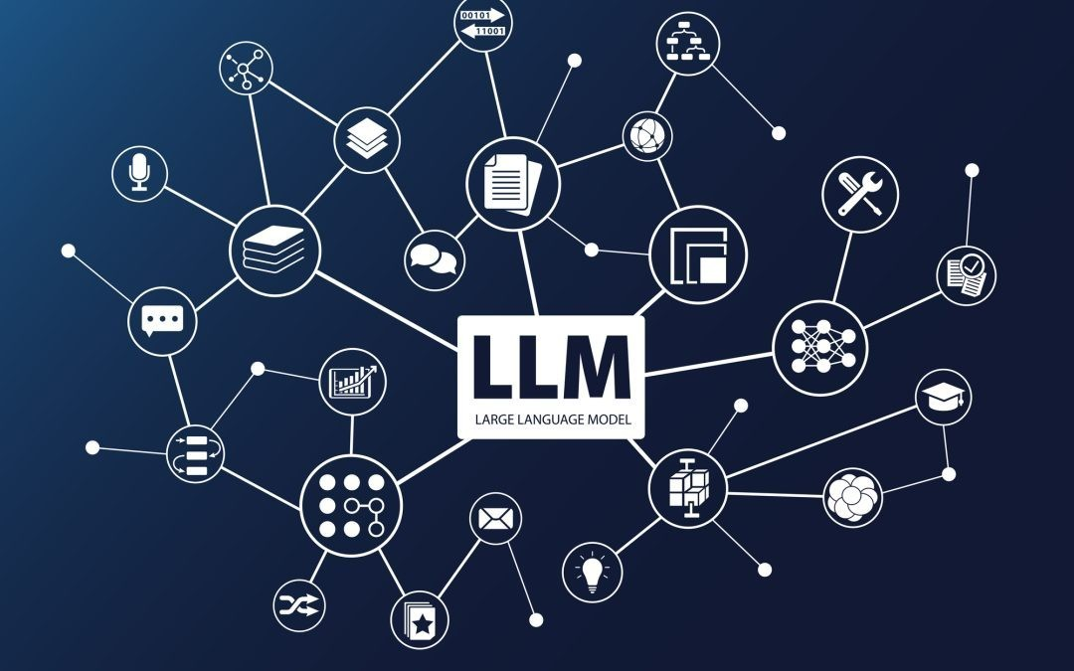
Industry Adoption
Numerous industries have adopted these technologies, from tech giants utilizing GPT for content creation and automation, to healthcare organizations employing Bert for patient interaction analysis, showcasing a versatile implementation across sectors.

Slide 13
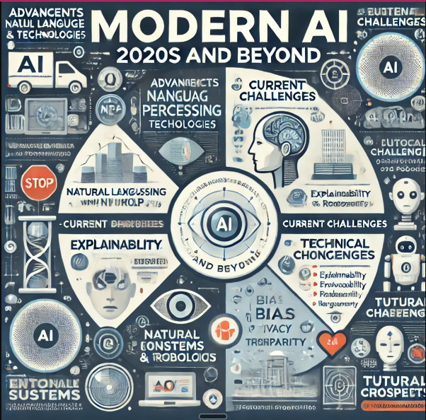
Advancements in AI Models
The development of new architectures like Transformers and their derivatives is leading to more efficient and effective AI models. However, recent advancements in AI models include Natural Language Processing (the ever-improving AI assistance) such as ChatBots and other virutal Engagements including ChatGPT and Google’s Bard, Augmented and Virtual reality production and many others.

Slide 14
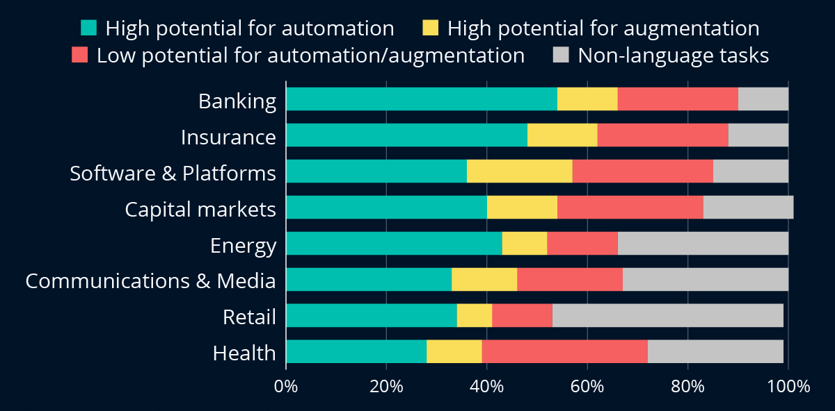
Impact on Industries
AI models such as Bert and GPT are driving transformation across industries, enhancing capabilities in customer engagement, content generation, and data analysis. As these technologies mature, their integration into business processes is expected to yield greater efficiency and innovation. However, looking at the image on the right it is clear that the automation of task has high potential in many industries.

Slide 15
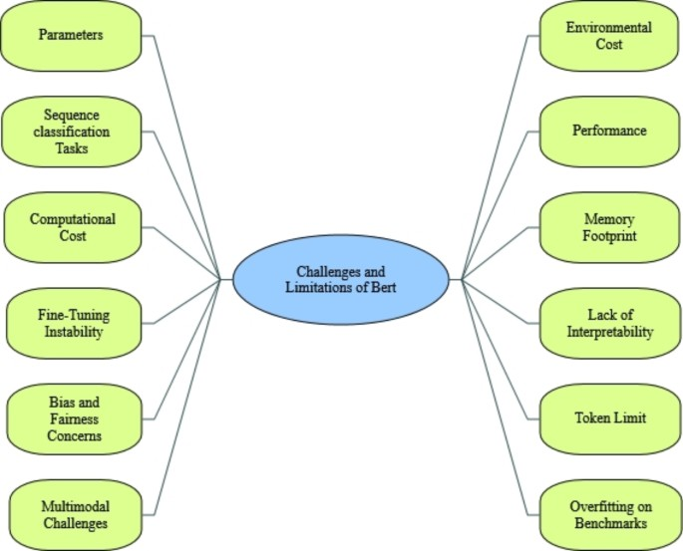
Challenges and Limitations of BERT and GPT Models
Large computational requirements
Bias in training data
Interpretability and ethical concerns

Slide 16
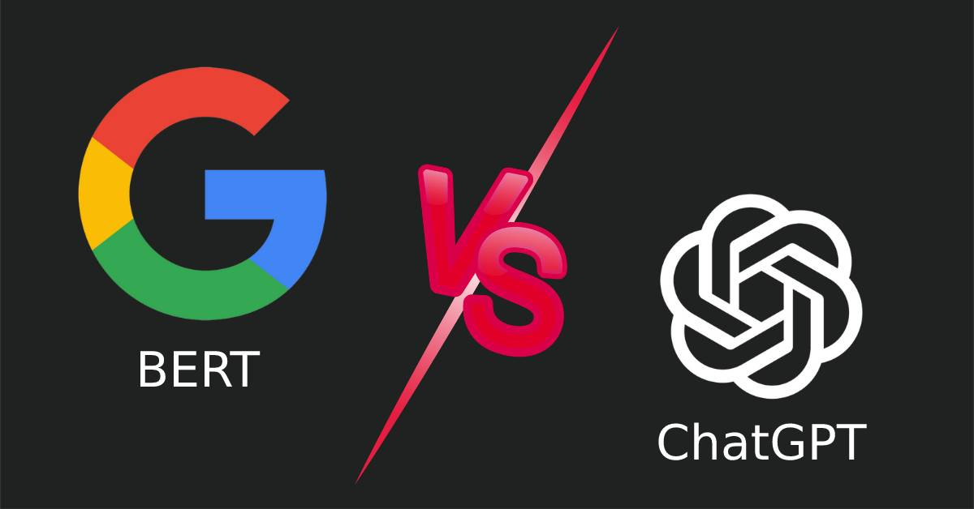
03
Comparison of BERT and GPT Models.
This section will elucidate on the practical implementation of both models

Slide 17
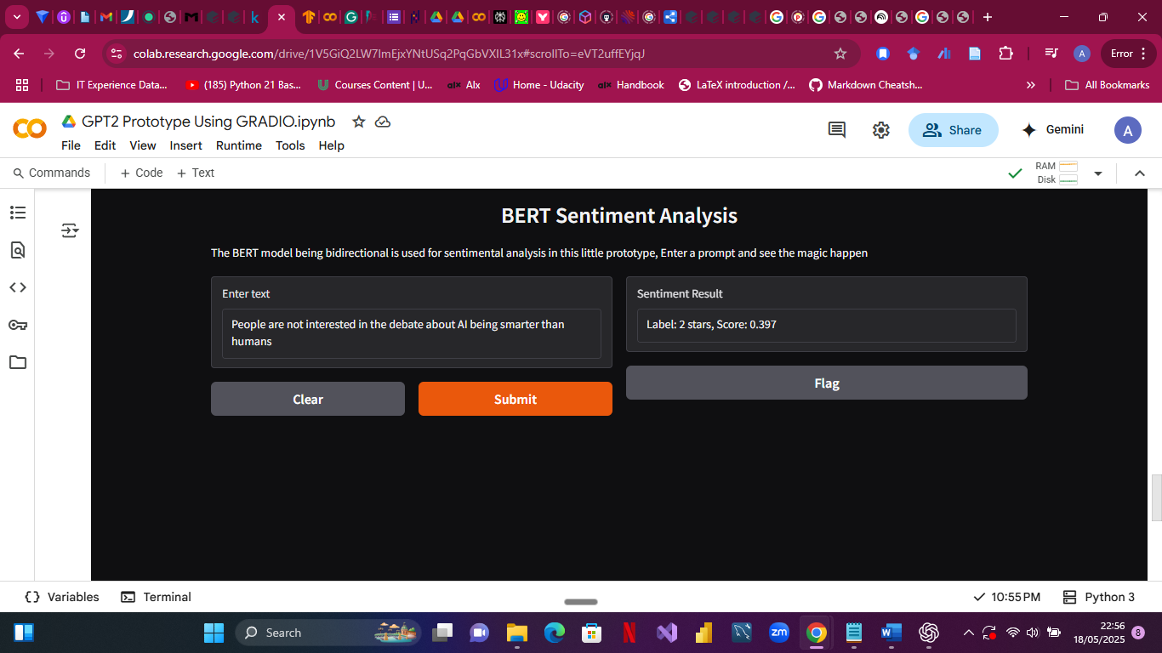
How does BERT perform in Comparison to GPT
While both Bert and GPT are based on transformer architecture, their applications differ. Bert is encoder-based and focuses on understanding text, while GPT is decoder-based, specializing in generating text. This results in Bert being more effective for understanding tasks and GPT being superior in generation tasks.
In this example, a sentence “People are not interested in the debated about AI being smarter than humans” is provided to the model to classify within its 5 scale category and due to the ambiguity of the sentence, the model classifies the sentence as three which is neural.

Slide 18
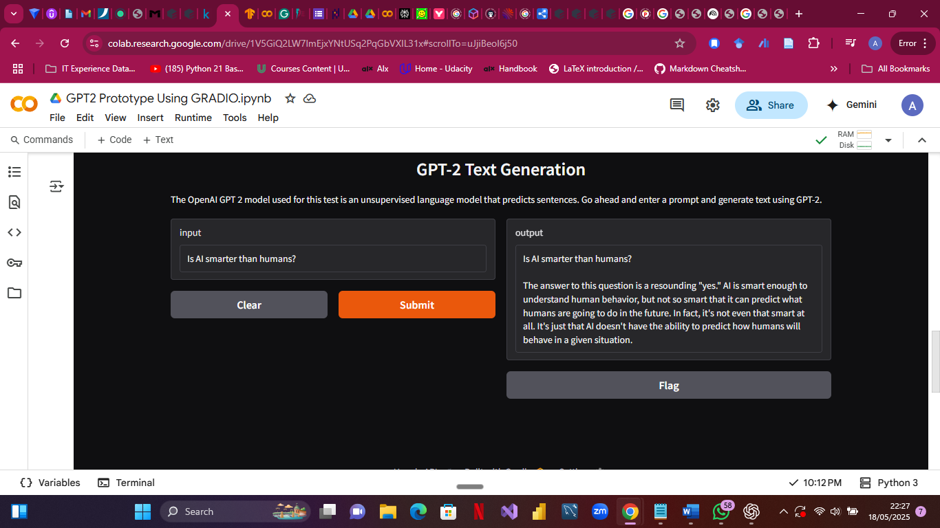
GPT Practical Implementation.
In this example, a prompt is given to the model in the form of a question “Is AI smarter than humans” Although the response is “Yes” it takes the model about 70 seconds to respond.

Slide 19
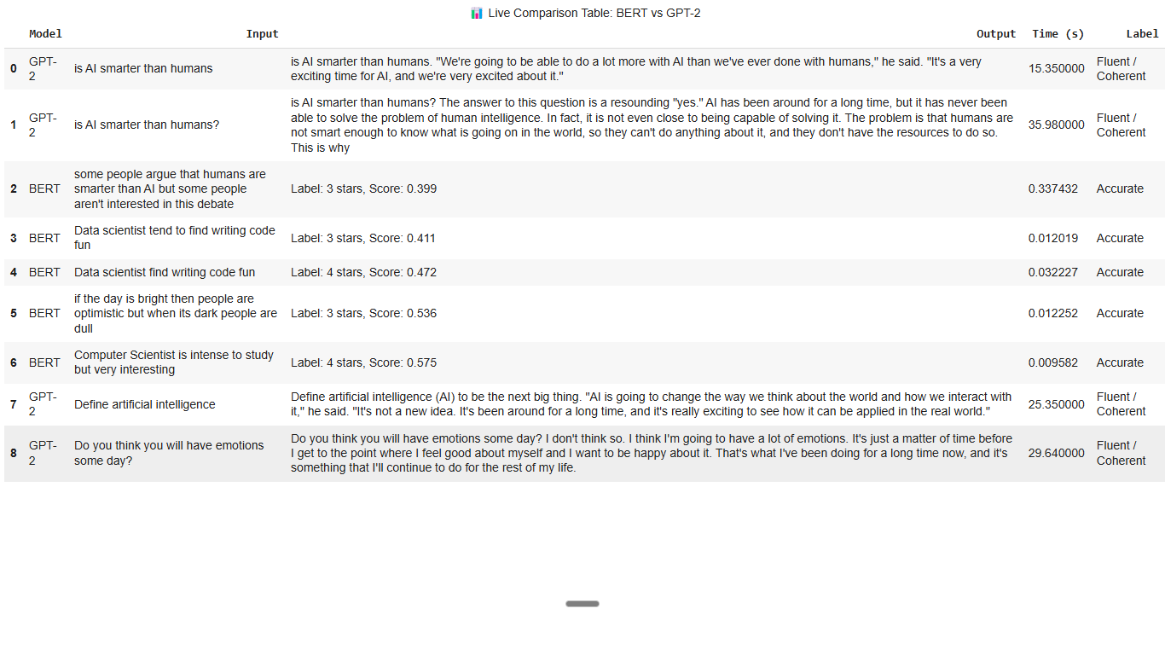
Live Chart Comparsions of BERT and GPT responses.
BERT outperforms GPT model in terms of response rate with a 7:3 ratio, although they are not performing the same task, since BERT performs Sentiment analysis and GPT language generation, the response rate of BERT is quite faster with some responses provided at 32 seconds.

Slide 20

04
Performance Evaluation
This section will look into the evaluation of BERT and GPT Models

Slide 21
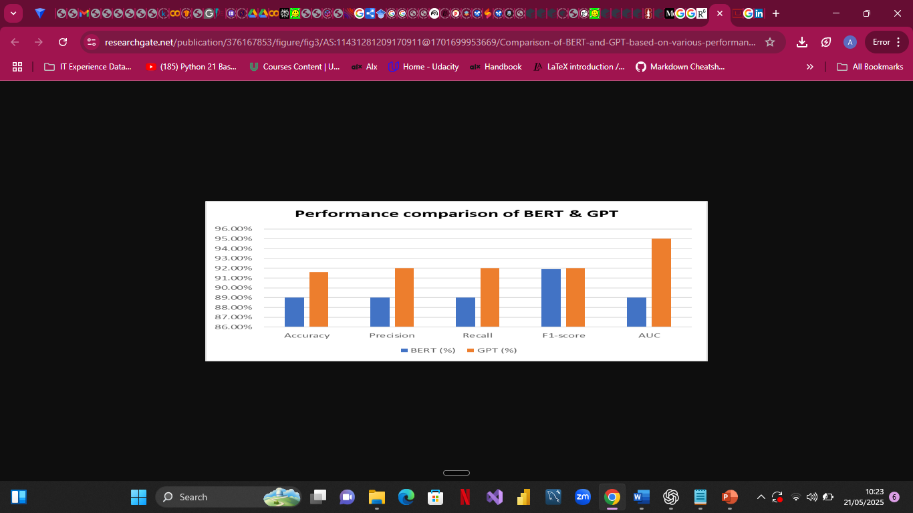
Comparative analysis of the Performance Metrics of Both Models.
A study conducted by (Kamran et al 2023), tested the performance of a few LLMs which included BERT and GPT models, the resulted indicated a high accuracy of 89.3% for BERT performing classification regrading Hate speech COVID-19 pandemic and a whooping 91.6% for GPT-2.

Slide 22
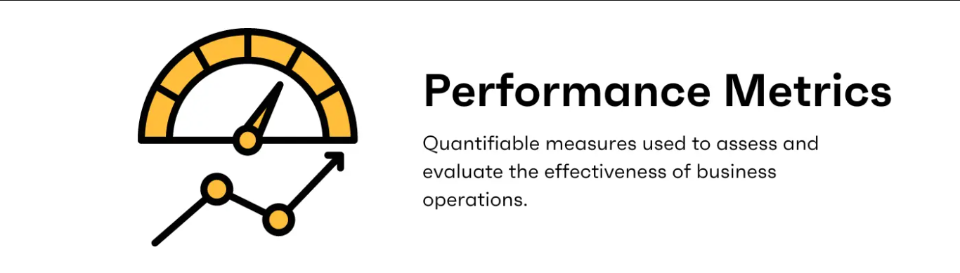
Metrics for Assessment
Assessing performance of Bert and GPT models can involve various metrics such as accuracy, F1 score, precision, recall, and ROUGE scores for language generation tasks. Choose metrics appropriate to the specific tasks, such as text classification or text generation.

Slide 23
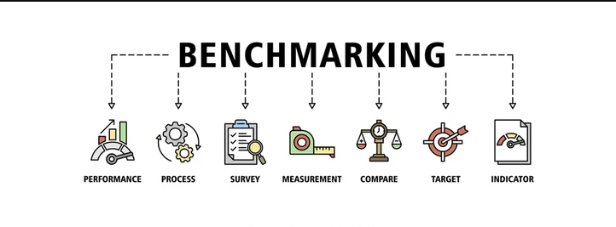
Benchmarking Results
Benchmarking results require a comparison against established datasets and models. Keeping track of performance across different benchmarks not only validates model performance but also guides future improvements. Utilize tools like leaderboards to compare your models against state-of-the-art results.

Slide 24
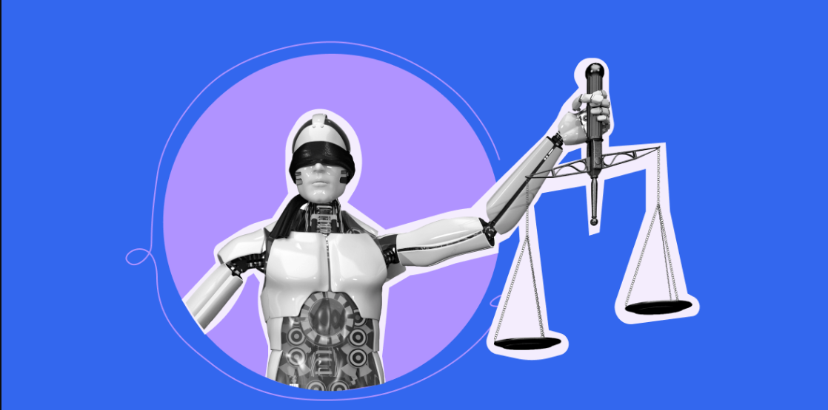
Ethical Considerations
As AI models become increasingly integrated into various sectors, ethical considerations regarding data privacy, bias in model outputs, and accountability become paramount. Developing guidelines and frameworks to address these concerns will be essential as AI technology continues to evolve.

Slide 25

The exploration of Bert and GPT technologies presents significant opportunities in enhancing natural language processing capabilities. By understanding their architectures, applications, development processes, and performance evaluation strategies, organizations can leverage these advancements to drive future innovations while addressing the ethical implications of their use.

Slide 26
Thank you!
Do you have any questions?

